Slide 1


Welcome to St Patrick’s
21st Sunday
Ordinary Time
Year B
You have entered a SACRED SPACE ... A SACRED TIME…
Please ensure all mobile phones are switched off.
Please be respectfully quiet as we prepare for our Celebration.
Notes:
Saturday 5.30PM First Sunday of Advent
16th Sunday in Ord Time Year B

Slide 2
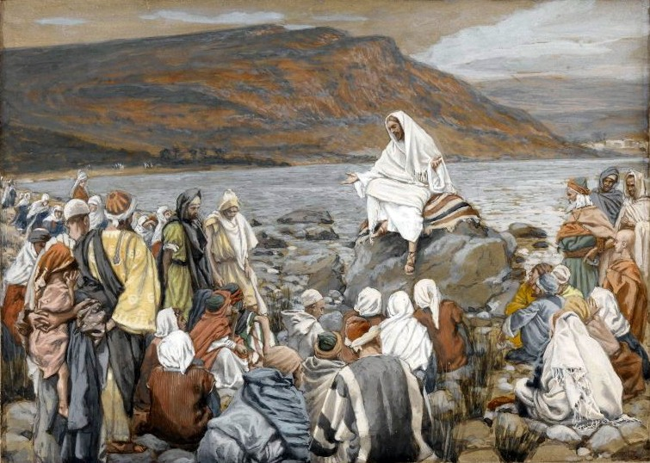
After hearing this a number of his disciples chose not to follow Jesus…
https://www.google.com.au/search?q=jesus&tbs=sur:fmc&source=lnms&tbm=isch&sa=X&ved=0CAgQ_AUoAWoVChMI0dvXpK2sxwIVBi6mCh3p2QpX&biw=1600&bih=731#tbs=sur:fmc&tbm=isch&q=jesus+followers&imgrc=I_EeQnreRu0AgM%3A

Slide 3
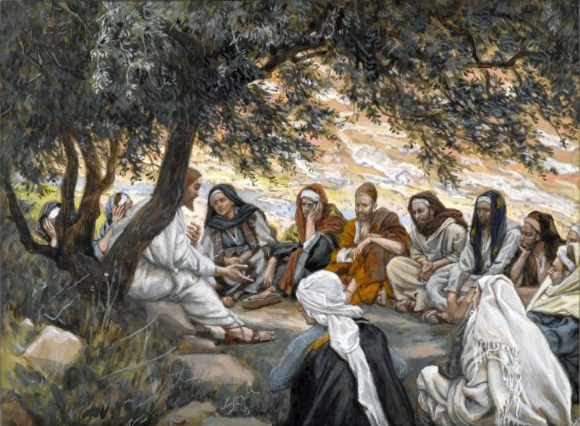
Then Jesus said to the Twelve, 'What about you, do you want to go away too?'

Slide 4
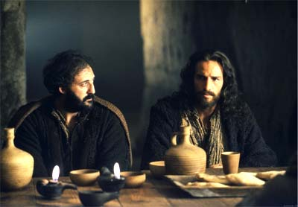
Simon Peter answered, 'Lord, who shall we go to?
You have the message of eternal life, and we believe; we know that you are the Holy One of God.'

Slide 5
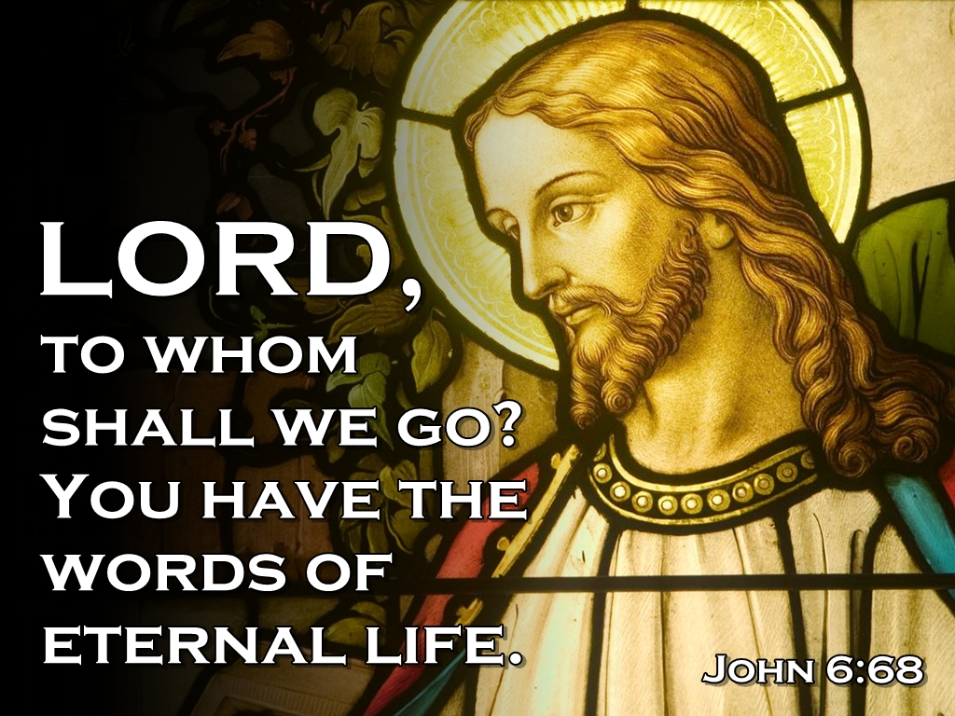
St Thomas Aquinas reminds us

Slide 6
PLEASE STAND

Slide 8
Penitential Act
Lord have mercy. Lord have mercy.
Christ have mercy. Christ have mercy.
Lord have mercy. Lord have mercy.
The English translation of The Roman Missal © 2010,
International Commission on English in the Liturgy Corporation. All rights reserved.

Slide 10
GLORIA
Glory to God in the highest,
and on earth peace to people of good will.
We praise you,
we bless you,
we adore you,
we glorify you,
we give you thanks for your great glory,
Lord God, heavenly King,
O God, almighty Father.

Slide 11
Lord Jesus Christ, Only Begotten Son,
Lord God, Lamb of God, Son of the Father,
you take away the sins of the world,
have mercy on us;
you take away the sins of the world,
receive our prayer;
you are seated at the right hand of the Father, have mercy on us.

Slide 12
For you alone are the Holy One,
you alone are the Lord, you alone are the Most High,
Jesus Christ, with the Holy Spirit,
in the glory of God the Father.
Amen.
The English translation of The Roman Missal © 2010,
International Commission on English in the Liturgy Corporation. All rights reserved.

Slide 14

Responsorial Psalm
Taste and see the goodness
of the Lord.

Slide 15
I will bless the Lord at all times, his praise always on my lips; in the Lord my soul shall make its boast.
The humble shall hear and be glad.
Taste and see the goodness of the Lord.

Slide 16
The Lord turns his face against the wicked to destroy their remembrance from the earth.
The Lord turns his eyes to the just and his ears to their appeal.
Taste and see the goodness of the Lord.

Slide 17
They call and the Lord hears and rescues them in all their distress.
The Lord is close to the broken-hearted; those whose spirit is crushed he will save.
Taste and see the goodness of the Lord.

Slide 18
Many are the trials of the just man but from them all the Lord will rescue him.
He will keep guard over all his bones, not one of his bones shall be broken.
Taste and see the goodness of the Lord.

Slide 19
Evil brings death to the wicked; those who hate the good are doomed.
The Lord ransoms the souls of his servants.
Those who hide in him shall not be condemned.
Taste and see the goodness of the Lord.

Slide 20


Slide 21
Gospel Acclamation
Alleluia, alleluia!
Your words, Lord, are spirit and life:
you have the words of everlasting life.
Alleluia!

Slide 23
APOSTLES’ CREED
I believe in God,
the Father almighty,
Creator of heaven and earth,
and in Jesus Christ, his only Son, our Lord,
(At the words that follow, up to and including the Virgin Mary, all bow.)
who was conceived by the Holy Spirit,
born of the Virgin Mary,
suffered under Pontius Pilate,
was crucified, died and was buried;
he descended into hell;

Slide 24
on the third day he rose again from the dead;
he ascended into heaven,
and is seated at the right hand
of God the Father almighty;
from there he will come to judge
the living and the dead.
I believe in the Holy Spirit,
the holy catholic Church,
the communion of saints,
the forgiveness of sins,
the resurrection of the body,
and life everlasting. Amen.

Slide 26
First Collection
This collection goes to the Bishop
for the support of the Diocese.
Thank you for your contribution

Slide 28
Holy, Holy, Holy
Holy, Holy, Holy Lord God of hosts,
Heaven and earth are full of your glory.
Hosanna in the highest
Blessed is he who comes
in the name of Lord,
Hosanna in the highest.
The English translation of The Roman Missal © 2010,
International Commission on English in the Liturgy Corporation. All rights reserved.

Slide 30
Save us, Saviour of the world,
for by your Cross
and Resurrection
you have set us free.
Memorial Acclamation
When we eat this Bread and drink this Cup, we proclaim your Death,
O Lord, until you come again.
We proclaim your Death, O Lord,
and profess your Resurrection
until you come again.
The English translation of The Roman Missal © 2010,
International Commission on English in the Liturgy Corporation. All rights reserved.
Notes:
Sunday 10AM First Sunday of Advent
7am - 14th Sunday in Ord Time
16th Sunday in Ord Time Year B

Slide 32
Amen
When we eat this Bread and drink this Cup, we proclaim your Death,
O Lord, until you come again.
Amen
We proclaim your Death, O Lord,
and profess your Resurrection
until you come again.
The English translation of The Roman Missal © 2010,
International Commission on English in the Liturgy Corporation. All rights reserved.
Notes:
Sunday 10AM First Sunday of Advent
7am - 14th Sunday in Ord Time
16th Sunday in Ord Time Year B

Slide 34
Lamb of God
Lamb of God, you take away the sins of the world, have mercy on us.
Lamb of God, you take away the sins of the world, have mercy on us.
Lamb of God, you take away the sins of the world, grant us peace.
The English translation of The Roman Missal © 2010,
International Commission on English in the Liturgy Corporation. All rights reserved.

Slide 36
Second Collection
What you contribute now
is for the support of our
parish and its mission.
Thank you for your generosity

Slide 37

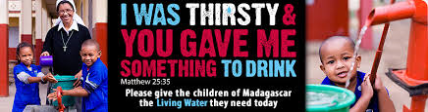

Slide 38
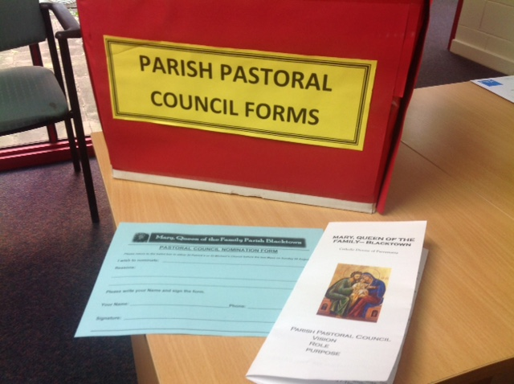
PARISH PASTORAL COUNCIL
Read Brochure
Pray and complete (blue)nomination form
Place form in Red Box at main door at each Church
Nominations close 7.00pm 29th August

Slide 39
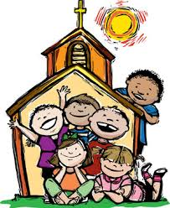
Children’s Liturgy
We require a number of leaders for Children’s Liturgy at St Patrick’s 10.00am Mass.
If you can assist write your name on the sign up sheets in the foyers or contact the Parish Office.

Slide 40


Slide 41

Certificate in
Pastoral Formation 2016
Early Bird Registrations Now Open
For further information contact the
  IFM or Parish Office

Slide 42
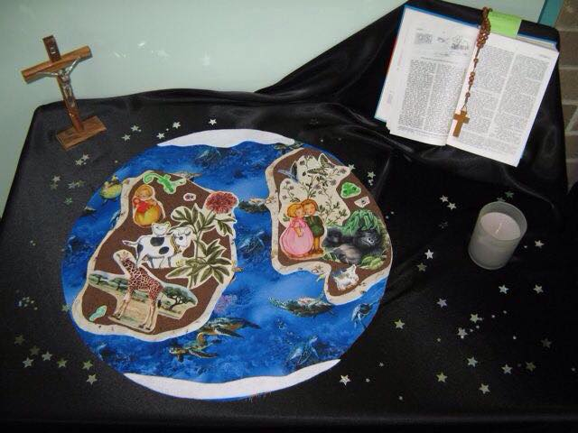
#prayerspacechallenge
Create a Prayer Space for your family.
Take a photo and upload it to our twitter feed; facebook page or email to us to upload.
Use the hashtag #prayerspacechallenge

Slide 43



JEAN & BETTY’S BUS TRIPS
Come on a great trip to Adelaide for a fantastic time with fantastic people and make new friends
10 days starting 18 October. Approx 1750.00pp
Contact Jean 99203401 or 0425251754

Slide 44



www.mqofblacktown.org.au
    www.facebook.com/blacktowncatholics
@mqofblacktown

